Slide 1


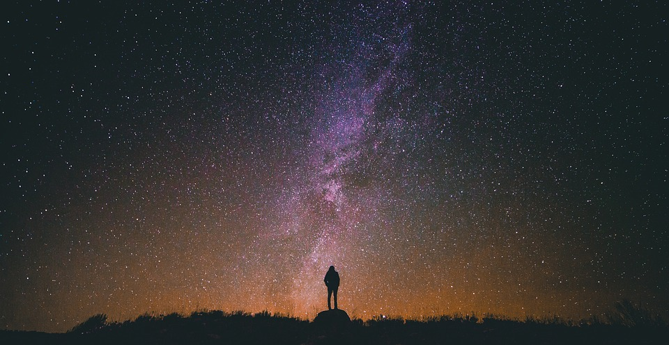
Introduction to Celestial Navigation
Theory
NN220-13
SEANAV I United States Naval Academy
NN220 – Fundamentals of Navigation– Updated May 2023
Operations Officer I HMS PROTECTOR A173 I The Ice Patrol Ship

Slide 2
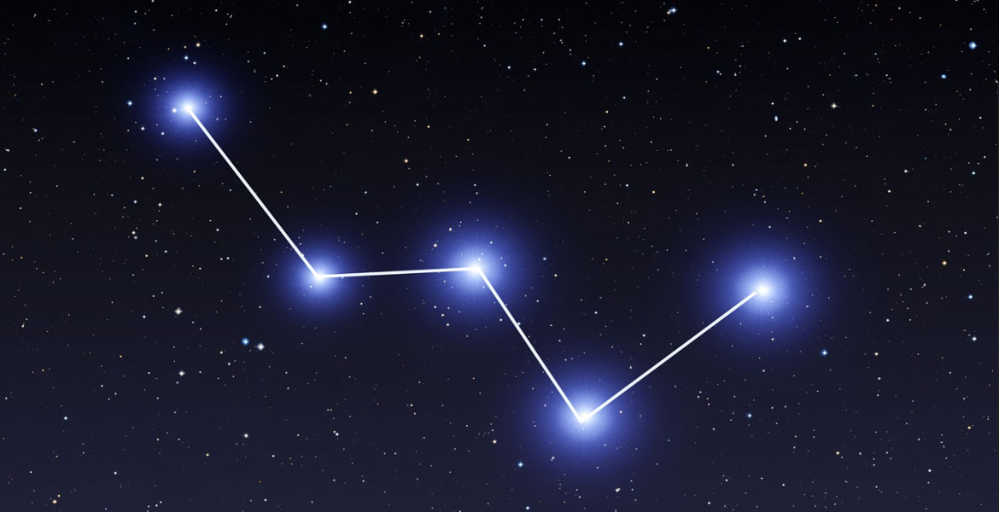
References
-The American Practical Navigator, Pub. No. 9, Bowditch, VOL. 1, 2019 Edition -Surface Ship Navigation Department Organizations and Regulations Manual (NAVDORM), COMNAVSURFPAC/COMNAVAIRPAC/COMNAVAIRLANT/COMNAVSURFLANT INSTRUCTION 3530.4 series -Nautical Almanac
SEANAV I United States Naval Academy
NN220 – Fundamentals of Navigation
Operations Officer I HMS PROTECTOR A173 I The Ice Patrol Ship

Slide 3
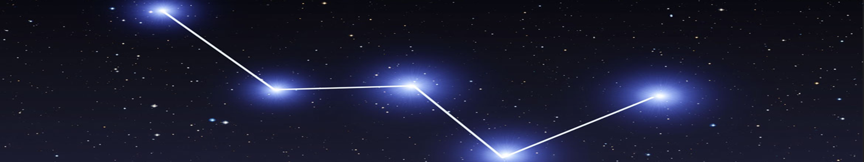
Enabling Objectives
1 – DESCRIBE the Terrestrial sphere and coordinate system. 2 - DESCRIBE How we perceive the Universe and Solar System in relation to the Earth. 3 - DESCRIBE the Celestial Sphere and Celestial Coordinate System. 4 - DESCRIBE the First Point of Aries in relation to Celestial Bodies. 5 - INTRODUCE the Nautical Almanac and STELLA. 6 - DEFINE the terms Assumed Position, Geographic Position and Observer’s Zenith in relation to the Celestial and Terrestrial Spheres. 7 - DEFINE the calculation for the relative movement of the Sun and Celestial Bodies. 8 - EXPLAIN the Celestial and Terrestrial Triangles and their relationship. 9 - EXPLAIN How to calculate CO-ALTITUDE and distance between the GP and AP from Altitude to gain an LOP. 10 - DESCRIBE The Horizon Coordinate System and its relationship to Altitude, Azimuth, GHA and Declination. 11 - INTRODUCE The Nautical Sextant. 12 - DEFINE The Nautical Sextant errors of Index Error, Perpendicularity, Side Error and Collimation Error. 13 - EXPLAIN Height Observed in relation to Height of Eye, Refraction and Environmental corrections.
SEANAV I United States Naval Academy
NN220 – Fundamentals of Navigation
Operations Officer I HMS PROTECTOR A173 I The Ice Patrol Ship

Slide 4
What are Stars?
https://www.youtube.com/watch?v=QZDk1cbKp7s
SEANAV I United States Naval Academy
NN220 – Fundamentals of Navigation
Operations Officer I HMS PROTECTOR A173 I The Ice Patrol Ship

Slide 5
How to Navigate Using the Stars!
https://www.youtube.com/watch?v=Bh5kHTBr0gU
SEANAV I United States Naval Academy
NN220 – Fundamentals of Navigation
Operations Officer I HMS PROTECTOR A173 I The Ice Patrol Ship

Slide 6
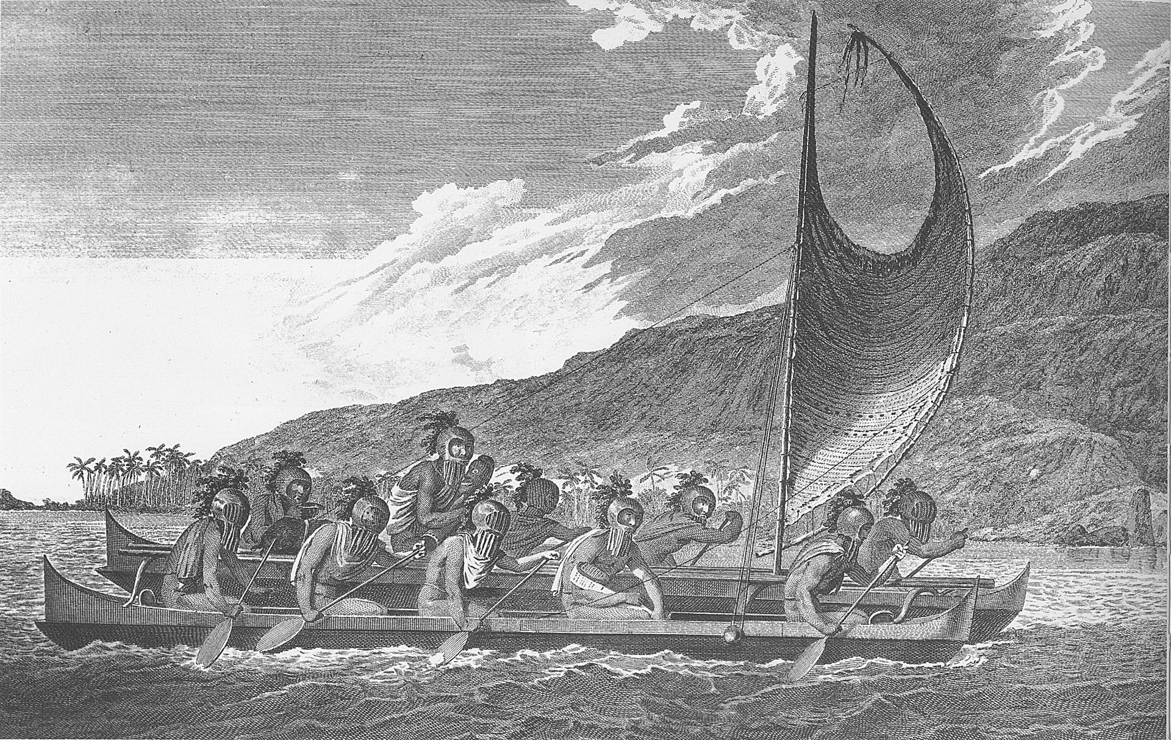
Why CELNAV?
-Celestial Navigation (CELNAV or ASTRONAV) has been used effectively for thousands of years.
-Ancient civilizations, from the Minoans to the Polynesians, successfully navigated vast oceans using CELNAV.
-We must be able to navigate by all means necessary.
-GPS is vulnerable.
-Visual and RADAR aids are unavailable upon the high seas.
-In the event of a loss of GPS in open ocean, CELNAV becomes an essential skillset to safely navigate.
SEANAV I United States Naval Academy
NN220 – Fundamentals of Navigation
Operations Officer I HMS PROTECTOR A173 I The Ice Patrol Ship

Slide 7
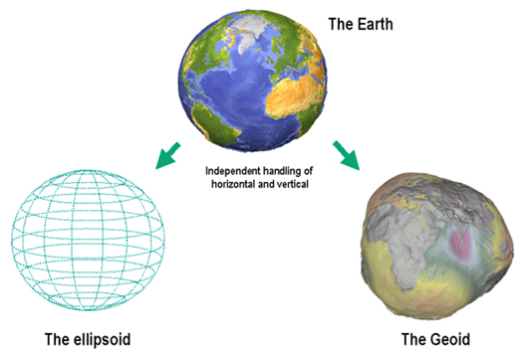
Terrestrial Navigation
-Celestial Navigation and Terrestrial Navigation are inextricably linked.
-We will rely on previously covered assumptions of Terrestrial Navigation:
-Mathematically, the Earth is described as an Ellipsoid or Spheroid.
-The Earth can be navigated as a sphere.
-We will use Spherical Trigonometry to calculate distances between places on the Earth.
-Math principles dictate that we need known information to find an unknown. With navigation, the known information becomes our established Points of Reference.
SEANAV I United States Naval Academy
NN220 – Fundamentals of Navigation
Operations Officer I HMS PROTECTOR A173 I The Ice Patrol Ship

Slide 8
Terrestrial Points of Reference
-On the Terrestrial Sphere (Earth), we use the following Reference Points:
North and South Poles: The point which represent the northernmost or southernmost point of the Earth’s Axis.
Prime Meridian: The reference point for lines of longitude. Longitude is measured East and West of the Prime Meridian.
Equator: The reference point for lines of Latitude, perpendicular to the Polar Axis and separates the North and South Hemispheres. Latitude is measured North and South of the equator.
Great Circle: Any circle that is formed by a plane that passes through the center of the Earth. Like any circle, they are 360°.
SEANAV I United States Naval Academy
NN220 – Fundamentals of Navigation
Operations Officer I HMS PROTECTOR A173 I The Ice Patrol Ship

Slide 9
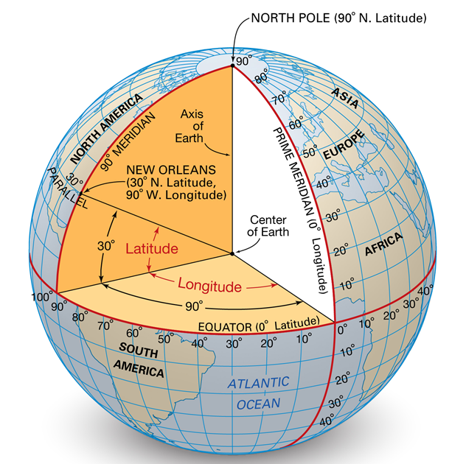
Terrestrial Navigation
-Latitude is the angular measurement of up to 90° between the equator and the North and South Pole.
1° of Latitude = 60 minutes
1 minute of Latitude = 1NM
1° of Latitude = 60NM of distance
The Latitude of USNA is 38° 50 minutes North of the Equator.
That is equal to 2330nm North of the Equator.
SEANAV I United States Naval Academy
NN220 – Fundamentals of Navigation
Operations Officer I HMS PROTECTOR A173 I The Ice Patrol Ship

Slide 10
Terrestrial Navigation
-Longitude is an angular measurement East or West of the Prime Meridian.
-Longitude is equated to Time.
-360° of longitude / 24hrs = 15° every hour
-1° of longitude = 4 minutes of time.
-USNA is approximately 77° west of the Prime
Meridian.
-77°/15 = 5 hours
-East Coast is in +5R
SEANAV I United States Naval Academy
NN220 – Fundamentals of Navigation
Operations Officer I HMS PROTECTOR A173 I The Ice Patrol Ship

Slide 11
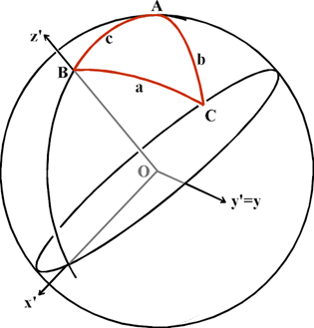
Spherical Trigonometry
-The shortest distance between two points on a sphere is a Great Circle.
-We can calculate the Great Circle distance between 2 sets of coordinates using Spherical Trigonometry.
-Example:
New York = 40° 47’N 73° 58’W
Moscow = 55° 45’N 37° 42’E
-Since we use reference points in Terrestrial Navigation, we know the location of the pole(s).
-Using the three vertices, we have a triangle.
cosp = cosm cosn + sinm sinn cos P
SEANAV I United States Naval Academy
NN220 – Fundamentals of Navigation
Operations Officer I HMS PROTECTOR A173 I The Ice Patrol Ship

Slide 12
Spherical Trigonometry
-This is not a math class, and we won’t get into the specifics of calculating this distance.
-The fundamentals, however are simple.
-(90°-Latitude) x 60 = Distance in NM a point is from the Pole.
-We know the position of New York (B), Moscow (C) and the North Pole (A) based on Latitude and Longitude.
-We know the distance New York is from the North Pole (shown as c in the picture) and the distance Moscow is from the North Pole (shown as b in the picture).
-With Spherical Trigonometry, we can find a, or the distance between New York and Moscow.
-Since this is on a sphere, it is a Great Circle, or the shortest distance between these two points!
SEANAV I United States Naval Academy
NN220 – Fundamentals of Navigation
Operations Officer I HMS PROTECTOR A173 I The Ice Patrol Ship

Slide 13
Breaking it down to math can be simple by separating it into individual parts:
cosp = cosm cosn + sinm sinn cos P
New York (N): Latitude l₁ = 40º47'N, Longitude L₁ = 73º58'W Moscow: (M): Latitude l₂ = 55º45'N, Longitude L₂ = 37º42'E.
n = 90º - l₁
90º - 40º47'N
= 49º13'.
m = 90º - l₂
90º - 55º45'N
= 34º15'.
P is the sum of the two longitudes, since one is East and the other is West:
P = L₁ + L₂ =
73º58’W + 37º42’E
= 111º40'.

Slide 14
cosp = cosm cosn + sinm sinn cos P
cosm cosn
Cos(m) = Cos 49.2 = 0.653
x
Cos(n) = Cos 34.25 = 0.826
=
0.539
sinm sinn cos P
Sin(m) = Sin 49.2 = 0.756
x
Sin(n) = Sin 34.25 = 0.562
x
Cos(P) = Cos 111.6 = -0.368
=
- 0.156
cosp
0.539
+
- 0.156
=
0.383
Arc(Cos)
0.383
=
67.48º
1º = 60nm therefore 60nm x 67.48^{o =} 4048.8nm

Slide 15
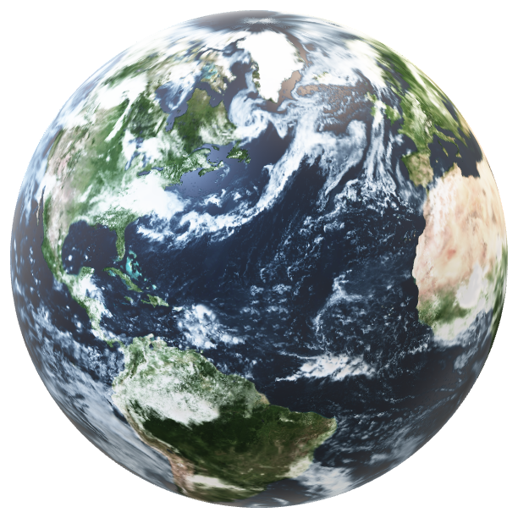
Terrestrial vs. Celestial
-These fundamentals will be critical in understanding Celestial Navigation.
-Much like Terrestrial Navigation, we will base CELNAV on Spherical Trigonometry and known reference points.
-But first, we will discuss some assumptions our ancestors made while performing CELNAV.
SEANAV I United States Naval Academy
NN220 – Fundamentals of Navigation
Operations Officer I HMS PROTECTOR A173 I The Ice Patrol Ship

Slide 16
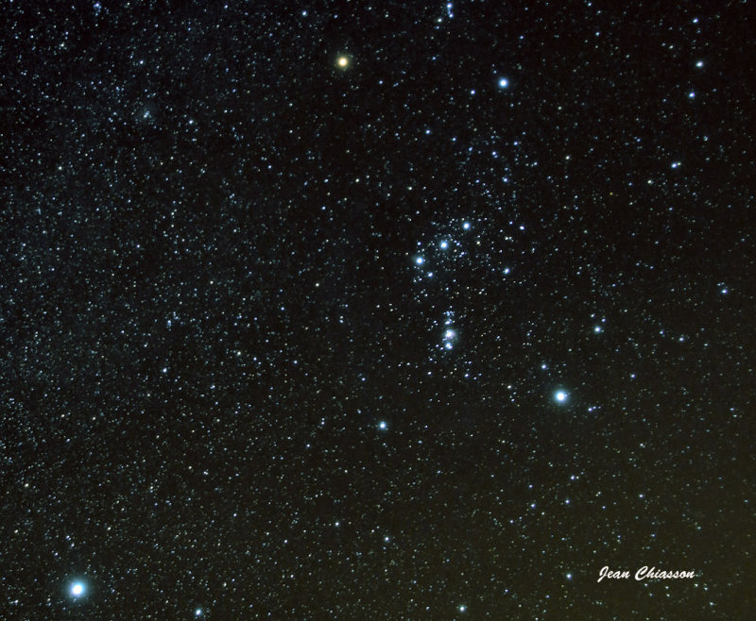
The Night Sky
Constellation Orion
-For thousands of years, Humans have looked to the night sky.
-We see thousands of Celestial Bodies, or natural objects in space, some which are easily identifiable.
-We organize Celestial Bodies into patterns, or maps that we call Constellations.
-Constellations are extremely useful in helping us identify the best stars to navigate with.
-Recognize this constellation?
Sirius, the brightest Star in the night sky and ideal for CELNAV
SEANAV I United States Naval Academy
NN220 – Fundamentals of Navigation
Operations Officer I HMS PROTECTOR A173 I The Ice Patrol Ship

Slide 17
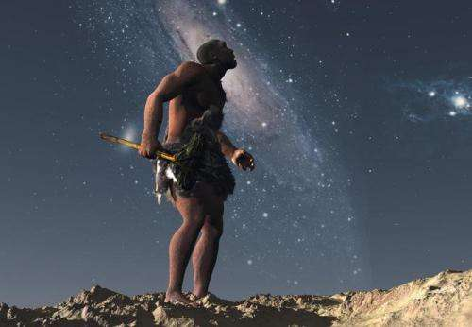
Earth is the Center of the Universe?
-Our ancestors looked into the night sky and believed that the Earth was the center of the universe.
-Celestial Bodies, including the Sun and Stars, appear to rise in the East and set in the West.
-To ancient people, it appeared that everything rotated around Earth.
-In reality, this movement is due to our own rotation.
-For CELNAV, we will use this assumption as it makes it easier to map the location of stars.
SEANAV I United States Naval Academy
NN220 – Fundamentals of Navigation
Operations Officer I HMS PROTECTOR A173 I The Ice Patrol Ship

Slide 18
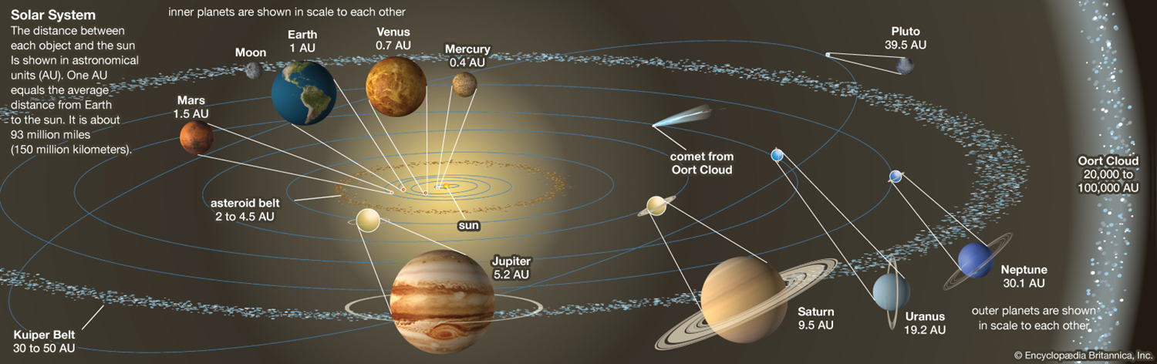
Understanding the Solar System
-The Earth completes 1 rotation on the axis of the Poles every 24 hours. This includes a cycle of light and darkness which is how we perceive a day.
-It takes the Earth 365 days, 5 hours and 59 minutes to orbit the Sun.
-The Earth orbits at an inclination of 23.5° to the celestial plane. This is why the Sun appears higher or lower in the sky depending on the time of year.
-The distance from the Earth to the Sun is described as 1AU = approx. 93 million miles.
SEANAV I United States Naval Academy
NN220 – Fundamentals of Navigation
Operations Officer I HMS PROTECTOR A173 I The Ice Patrol Ship

Slide 19
Understanding the Solar System
-In our Solar System, the Earth orbits the Sun along with 8 other planets.
-There are many other bodies in the Solar System, including some we can see with the naked eye such as the Moon.
-The Moon orbits the Earth which take 27.3 days.
-The gravitational effect of the Moon’s orbit gives the Earth features such as Tides.
SEANAV I United States Naval Academy
NN220 – Fundamentals of Navigation
Operations Officer I HMS PROTECTOR A173 I The Ice Patrol Ship

Slide 20
Coordinate Systems
https://youtu.be/0cbKcaTimMI
SEANAV I United States Naval Academy
NN220 – Fundamentals of Navigation
Operations Officer I HMS PROTECTOR A173 I The Ice Patrol Ship

Slide 21
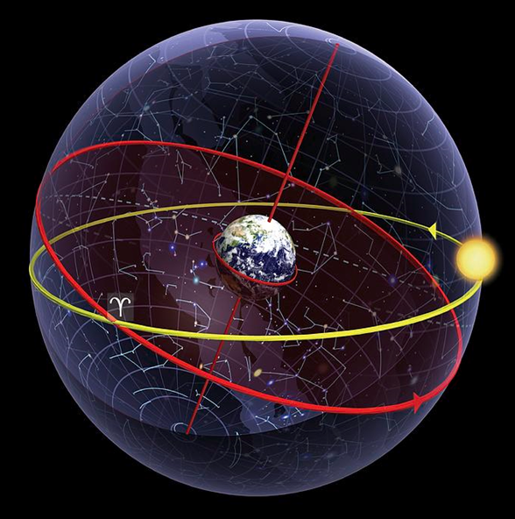
The Celestial Sphere
-The Sun and Planets are at a measurable distance within our Solar System.
-For CELNAV, stars however are described as being at an infinite distance.
-All the Celestial Bodies outside our Solar System are projected onto the Celestial Sphere, or an imaginary sphere of infinite radius with Earth at its center.
-The Sun and the Celestial Bodies within our Solar System, such as the planets, are perceived to be moving within the sphere.
-Just like Terrestrial Navigation, we can create reference points and a coordinate system on the Celestial Sphere.
-We can also use Spherical Trigonometry to map Celestial Body positions.
-However, since we are dealing with infinite distances, we have to interpret their positions using angles (degrees) rather than distance (Nautical Miles).
SEANAV I United States Naval Academy
NN220 – Fundamentals of Navigation
Operations Officer I HMS PROTECTOR A173 I The Ice Patrol Ship

Slide 22
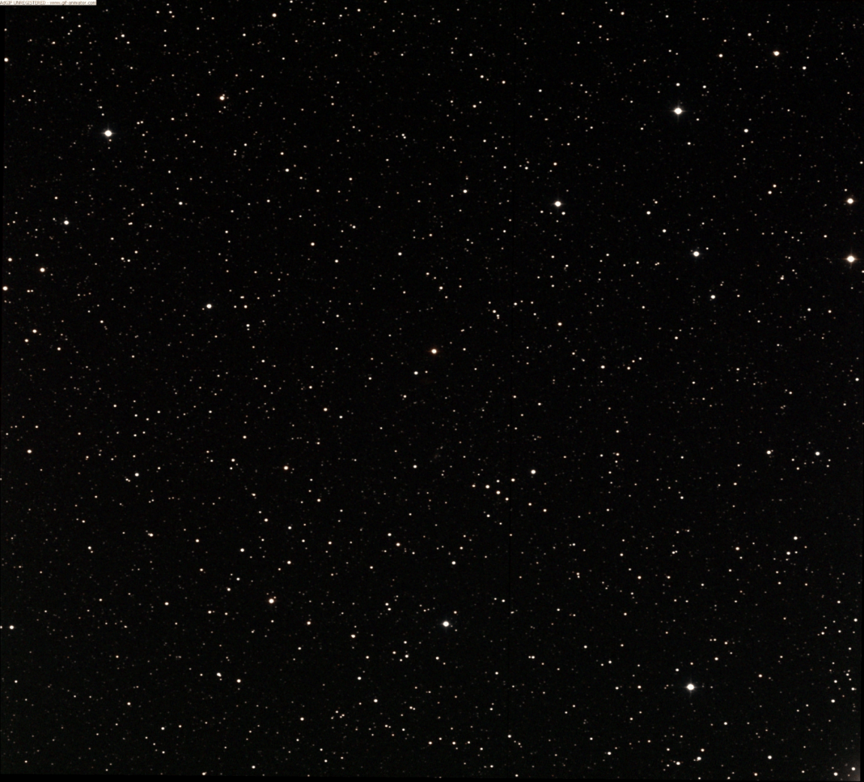
Celestial Coordinate System
As with the Terrestrial Sphere, we need points of reference for a coordinate system to make sense of the Celestial Sphere.
North Celestial Pole (P_{N})
The North and South Pole are projected on the Celestial Sphere as the Celestial Poles.
Terrestrial North Pole
Greenwich Meridian
Prime Meridian
The Earth’s Equator is projected as the Equinoctial (Celestial Equator)
Equator
The Greenwich Mean Line or Prime Meridian is projected as the Greenwich Meridian.
Equinoctial
Terrestrial South Pole
South Celestial Pole (P_{N})

Slide 23
Celestial Coordinate System
Now we have points of reference on the Celestial Sphere, we can introduce a coordinate system to plot the position of Celestial Bodies on the Celestial Sphere.
Celestial Body
Longitude is measured on the Earth’s surface 180° East or West of the Prime Meridian.
Greenwich Meridian
Greenwich Hour Angle
Celestial Bodies sit on a Hour Circle that is similar to Longitude; a great circle, that joins between the Celestial Poles.
The Greenwich Hour Angle (GHA) is the angle between the Greenwich Meridian and the Celestial Body’s Hour Circle.
Hour Circle

Slide 24
Celestial Coordinate System
Unlike Longitude which is measured East or West of the Greenwich Meridian, GHA is measured between 0-360° clockwise (westerly) from the Greenwich meridian.
Celestial Body
Because of the Earth’s orbit around the Sun, the GHA of Celestial Bodies change throughout the day.
Greenwich Meridian
Greenwich Hour Angle
The Earth’s 360° / 24hrs = approximately 15° of change to GHA per hour for each Celestial Body on the Celestial Sphere.
The rate of change to GHA for Bodies within the Celestial Sphere such as planets have a different rate of change because of their own orbit within the Solar System.
Hour Circle

Slide 25
Celestial Coordinate System
Where Latitude is an angle North or South of the Equator, Declination is the Celestial Body’s position measured as an angle North or South of the Celestial Equator.
The Angle is a measurement between the Celestial Equator and Polar North or South.
Declination of a Celestial Body such as a star doesn’t change, in reference to the Equinoctial. That’s why we can’t see Stars such as Polaris from the Southern Hemisphere.
Declination
Equinoctial
However, Declination of bodies within our Solar System, such as the Planets, do change because of their orbit of the Sun.

Slide 26
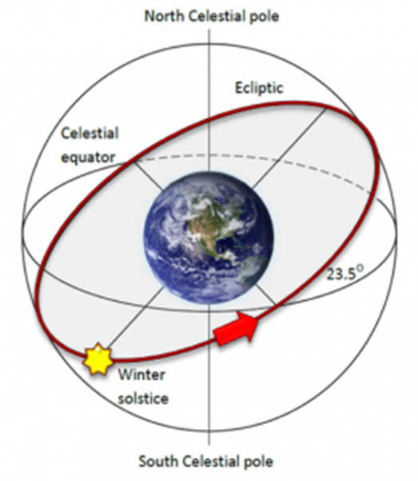
Earth’s Inclination
-Earth’s orbit is at an inclination of 23.5° to the Sun.
-However, the Sun is perceived as being between the Celestial Sphere and Earth. Therefore, we perceive its declination as changing.
-The Sun’s declination moves from 23.5° South to 23.5° North throughout the year.
-This change of declination gives us seasons.
-When the Sun is in a Northerly declination, the Northern Hemisphere has longer days and summer weather.
-When the Sun is in a Southerly declination, the Southern Hemisphere has longer days and summer weather.
-The longest day for the Northern Hemisphere is the Summer Solstice on June 20 and the shortest day is the Winter Solstice on 20 December. During these times, the Sun is at either its maximum Northerly or Southerly declination.
-The Equinoxes mark when the Sun’s declination is 0° and the Sun passes the Equator from north to south or vice versa.
SEANAV I United States Naval Academy
NN220 – Fundamentals of Navigation
Operations Officer I HMS PROTECTOR A173 I The Ice Patrol Ship

Slide 27

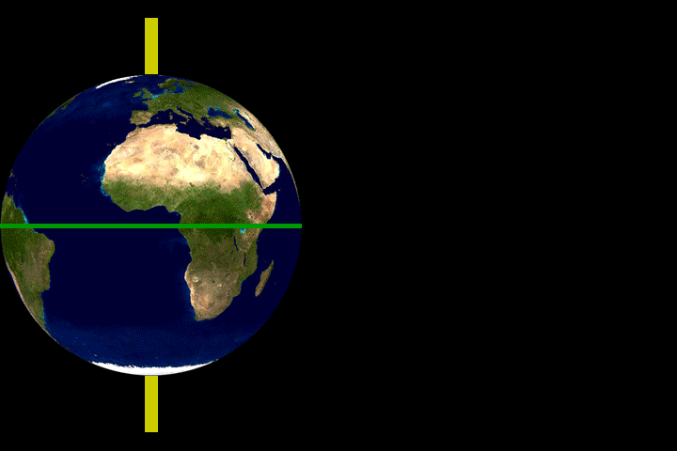


Slide 28
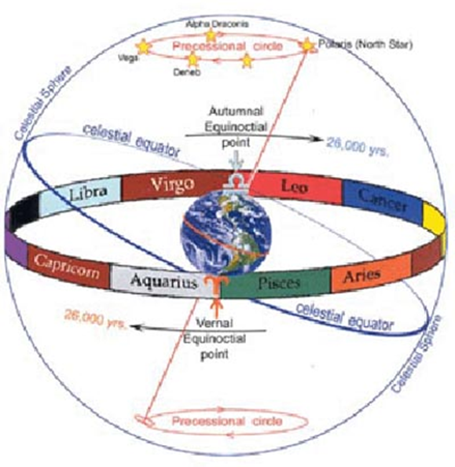
Identifying Celestial Bodes
-The Ancient Greeks celebrated the Vernal Equinox in March, when the Sun’s declination was neither North or South.
-At the Vernal Equinox, the First Point of Aries was used as a visual point of reference as they aligned. The Aries Constellation aligned with the Equinox, and this had significance to the Ancient Greeks.
-The GHA of the First Point of Aries changes on a daily basis. This has been predicted and catalogued in the Nautical Almanac.
SEANAV I United States Naval Academy
NN220 – Fundamentals of Navigation
Operations Officer I HMS PROTECTOR A173 I The Ice Patrol Ship

Slide 29
Identifying Celestial Bodes
-Celestial Bodies do not move in relation to each other. The angular measurement between two stars will always be the same.
-All Celestial Bodies can be related to the First Point of Aries. The angular measurement from the First Point of Aries to the Celestial Body is called its Sidereal Hour Angle.
-If you know the GHA for the First Point of Aries on any day for any hour, you can add a Celestial Body’s SHA (which never changes) to the GHA of the First Point of Aries (which does change but has been predicted).
-This will immediately give me that Celestial Body’s GHA for that day and hour!
-This is useful, because the alternative would be to map the GHA of every Celestial Body for every hour of every day for years to build a consistent map. This would take a very long time!
-The First Point of Aries provides a shortcut…a reference to find any CB’s GHA without having to spend the time to map and predict a CB’s movement.
SEANAV I United States Naval Academy
NN220 – Fundamentals of Navigation
Operations Officer I HMS PROTECTOR A173 I The Ice Patrol Ship

Slide 30
Sidereal Hour Angle
Stars change position on the Celestial Sphere minimally.
They are referenced to the GHA of Aries to identify other stars.
Greenwich Meridian
CB’s SHA
GHA of Aries + SHA of CB = CB’s GHA
GHA for the First Point of Aries
As the Earth orbits the Sun the GHA of Aries changes.
SEANAV I U.S. Naval Academy I Celestial Navigation
NN220 - Fundamentals of Navigation

Slide 31
Procession
-Due to the Earth’s procession, or the movement on its Axis, there are changes to how we perceive CB’s meaning their declination and GHA change by a small margin.
-Due to procession, the First Point of Aries changes by approximately 1° every 72 years.
-Today, the First Point of Aries is actually located within the Pisces Constellation.
-In 23,000 years, the First Point of Aries will be aligned again with the Aries Constellation.
-Since we know this, we can account for it!
SEANAV I United States Naval Academy
NN220 – Fundamentals of Navigation
Operations Officer I HMS PROTECTOR A173 I The Ice Patrol Ship

Slide 32
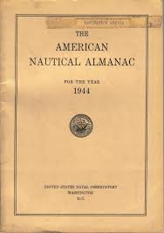
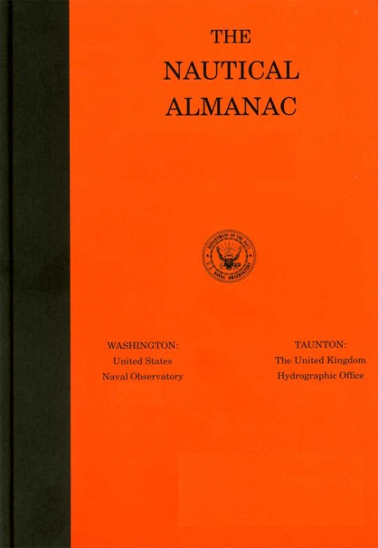
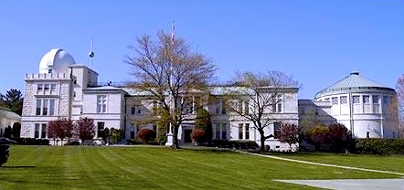
Nautical Almanac
The Nautical Almanac was first published in 1767 and is produced annually in consultation between the USNO and UKHO.
It lists:
- GHA for the First Point of Aries by Day / Hr.
- GHA and Declination of the 4 Navigable planets in our Solar system by Day / Hr;
- Venus, Mars, Jupiter and Saturn.
- GHA and Declination for the Sun by Day / Hr.
- GHA and Declination for the Moon Daily.
- Sunrise / Sunset / Twilight
- Moonrise / Moonset

Slide 33
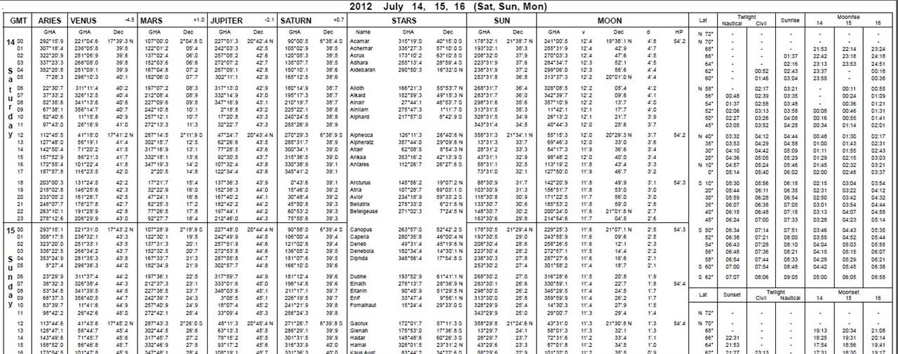
CELESTIAL BODY
SHA and Declination
TIME (GMT)
SUN GHA and Declination
GHA for the FIRST POINT OF ARIES
TWILIGHT (N/C)
SUNRISE-SET
MOONRISE-SET
PLANETS GHA / DECLINATION
MOON
SEANAV I U.S. Naval Academy I Celestial Navigation
NN220 – Fundamentals of Navigation

Slide 34
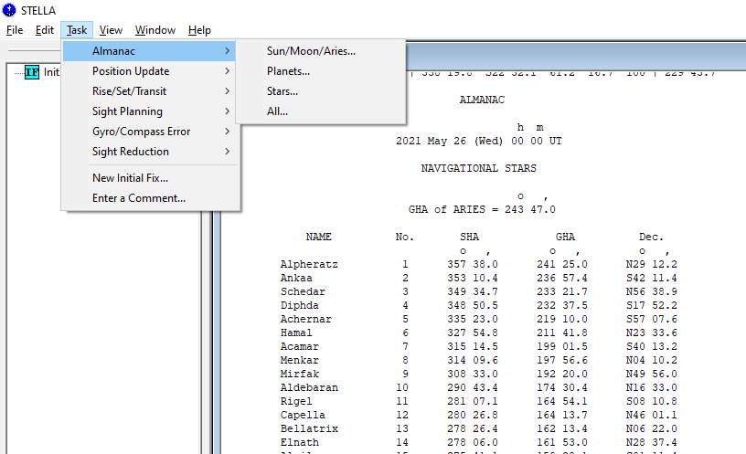
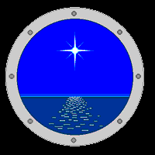
Identification of Stars – Nautical Almanac
The information within the Nautical Almanac is also available electronically through systems such as STELLA – System to Estimate Latitude and Longitude Astronomically.
Astronomical information such as Declination and GHA can be found for dates as required.
But unlike the Nautical Almanac, STELLA will do the math for you!
STELLA will provide the GHA and Declination of any Celestial Body for any time, based on the GHA of Aries.

Slide 35
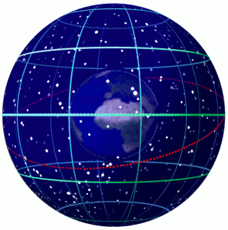
Celestial vs. Terrestrial Navigation
-Using the Coordinate System from the Celestial Sphere (Declination/GHA) we can plot any navigable Celestial Body’s future position on the Celestial Sphere.
-We must relate this information to the Terrestrial Sphere and vice versa.
-Remember the example with finding the distance between New York and Moscow? If we know 2 positions on a triangle, we can calculate the third.
SEANAV I United States Naval Academy
NN220 – Fundamentals of Navigation
Operations Officer I HMS PROTECTOR A173 I The Ice Patrol Ship

Slide 36
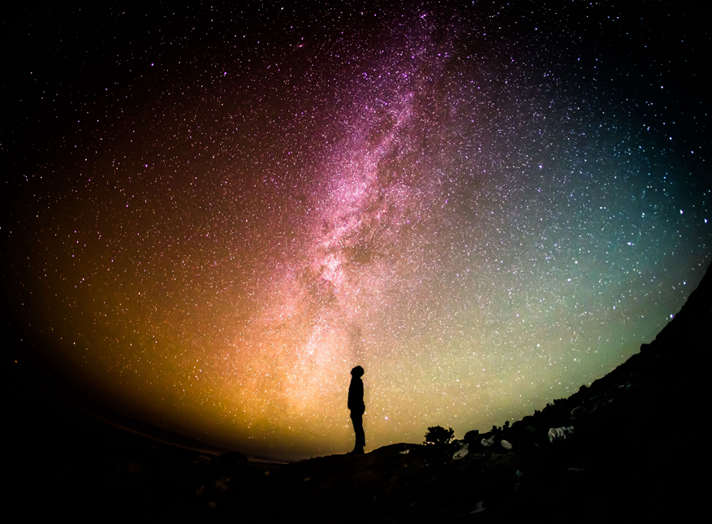
Celestial vs. Terrestrial Navigation
-Assumed Position (AP) – Where we think we are going to be at a specific time. Also known as Dead Reckoning (DR) based on our Course and Speed.
-If I stood at our AP on Earth’s surface, if we look directly upwards at 90°, our position projected on to the Celestial Sphere is called our Zenith (Zn).
-Therefore Zenith and AP are related.
Zenith Position on the Celestial Sphere
Assumed Position (AP) on Earth’s Surface
SEANAV I United States Naval Academy
NN220 – Fundamentals of Navigation
Operations Officer I HMS PROTECTOR A173 I The Ice Patrol Ship

Slide 37
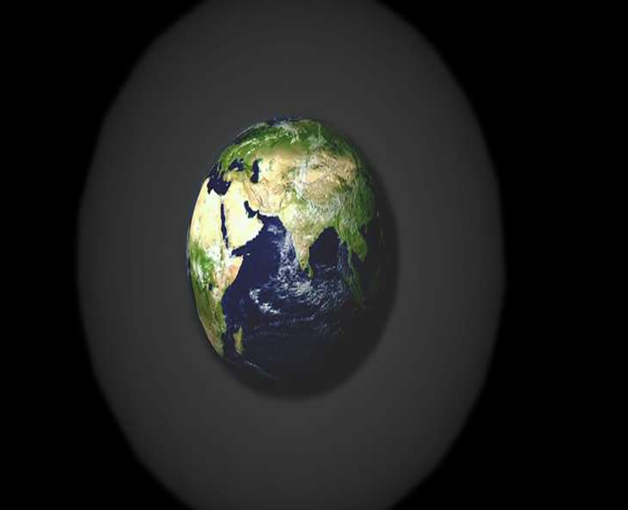
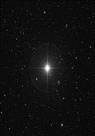
Celestial vs. Terrestrial Navigation
-If a line was drawn from a Celestial Body (CB) at 90° towards the Earth’s center, the position of the Earth is the Geographic Position (GP) of a star or body.
-This is the opposite of a Zenith as is called a Nadir.
-Therefore CB and GP are related.
-If you look up at your zenith and see a star at 90° above you, you are on its GP.
-Just as the GHA moves due to the Earth’s rotation, the GP moves.
CB
Nadir
GP
SEANAV I United States Naval Academy
NN220 – Fundamentals of Navigation
Operations Officer I HMS PROTECTOR A173 I The Ice Patrol Ship

Slide 38
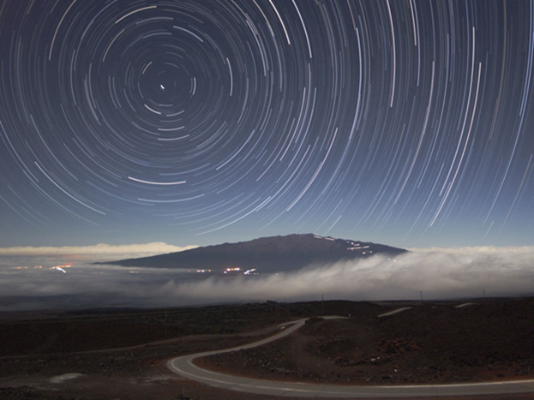
Name that Star!
-If you stood at the Earth’s North Pole and looked directly up at your Zenith, what star would you see?
-Polaris, which is the star whose GP sits roughly on top of the North Pole.
-It cannot be seen south of the Equator!
SEANAV I United States Naval Academy
NN220 – Fundamentals of Navigation
Operations Officer I HMS PROTECTOR A173 I The Ice Patrol Ship

Slide 39
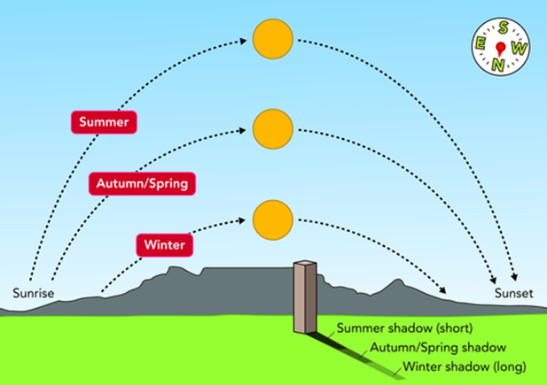
Apparent Movement
-All Celestial Bodies have an apparent movement across the sky.
-The Sun’s rate changes based on the observer’s latitude, the time of year, and the declination of the sun.
-At the equator, the apparent speed of the Sun across the sky is:
21,600NM (circumference at the equator)/24hrs = 900 kts
-At USNA, the apparent speed of the Sun across this sky is:
900kts x Cosine Latitude(38.9) = 700 kts
-This means that the GP of the sun moves very fast across the surface of the Earth. A star’s GP likely moves fast as well.
-Timing for CELNAV is critical.
SEANAV I United States Naval Academy
NN220 – Fundamentals of Navigation
Operations Officer I HMS PROTECTOR A173 I The Ice Patrol Ship

Slide 40
Celestial vs. Terrestrial Navigation
-We have talked about the relationship between the Celestial Sphere and the Terrestrial Sphere (Earth).
(AP and Zenith, CB and GP)
-Let’s further define this relationship.
SEANAV I United States Naval Academy
NN220 – Fundamentals of Navigation
Operations Officer I HMS PROTECTOR A173 I The Ice Patrol Ship

Slide 41
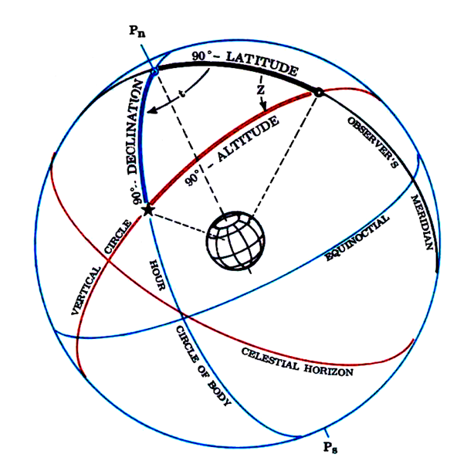
The Celestial Triangle
-The 3 vertices of the Celestial Triangle are:
Celestial North or South Pole (CP)
The Celestial Body (CB)
Observer’s Zenith (Zn)
-Since stars are infinite distances from Earth, we focus on the angle rather than distances.
-With Spherical Trigonometry, with 2 known reference positions, the 3rd can be calculated.
-We know both the position of the CP and the CB. Knowing these 2 angles, we can calculate the position of the Zn on the Celestial Sphere.
-Let’s relate this to Terrestrial Navigation!
SEANAV I United States Naval Academy
NN220 – Fundamentals of Navigation
Operations Officer I HMS PROTECTOR A173 I The Ice Patrol Ship

Slide 42

Celestial Pole (CP)
Celestial
Triangle
(CP-CB-Zn)
Celestial Body (CB)
Zenith (Zn)
Polar North
Celestial Body’s Geographic Position (GP) projected on the Earth’s Surface
Observer’s Assumed Position (AP). In real terms, our DR position.
Navigational
Triangle
(Pole-GP-AP)

Slide 43
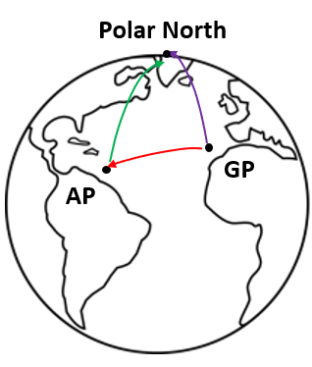
The Navigation Triangle
-We now have a triangle on the Earth’s surface!
-We can predict where the GP of a Celestial Body is at a given time since we know its Declination and GHA.
-We know the position of the North/South Pole.
-The 3rd position is our AP, or the DR which is a position based on our course and speed.
-Since it is on Earth, we can calculate the distance between our AP and the GP of a Celestial Body in Nautical Miles (NM).
-This assumes our AP is known exactly. We use CELNAV to find the difference between our actual position and our AP.
SEANAV I United States Naval Academy
NN220 – Fundamentals of Navigation
Operations Officer I HMS PROTECTOR A173 I The Ice Patrol Ship

Slide 44
The Navigation Triangle
North Pole
Our Assumed Position (AP)
Normally the result of Dead Reckoning
Described as Lat / Long
Our DR Latitude is measured North of the Equator as an Angle.
For example, 25° North.
Remember 1° Latitude = 60nm
Our distance from the equator is 25° x 60nm
In this case – 1500nm.
Equator
So how far is it to the North Pole?

Slide 45
The Navigation Triangle
A Right Angle Triangle is drawn between the Pole and Centre of the Earth, where the angle from the Equator to the Pole is 90°
North Pole
If our Latitude is 25°, the remaining angle is described as the CO-LATITUDE
90° - Latitude = CO-LATITUDE
90° - 25° = 65°
65° x 60nm = 3900nm to the North Pole
Equator

Slide 46
The Navigation Triangle
A Celestial Body is represented on the Earth’s surface by its Geographic Position (GP).
North Pole
Where AP is based on Latitude related to the Equator, a Celestial Body’s (CB) position North or South of the Celestial Equator is described by its Declination.
This can still be related to the Earth’s Equator through the GP.
CO-DEC
CO-LAT
Assumed Position (AP)
GP
DEC
The remaining Angle between GP and the North Pole is described as CO-DECLINATION.
90 – DECLINATION = CO-DECLINATION
Equator

Slide 47
Horizon Coordinate System
-The last portion of the puzzle is to find the distance from the AP to the GP.
-To do this, we use the Horizon Coordinate System.
SEANAV I United States Naval Academy
NN220 – Fundamentals of Navigation
Operations Officer I HMS PROTECTOR A173 I The Ice Patrol Ship

Slide 48
Horizon Coordinate System
-To conduct CELNAV, we must have an AP, which means we need an initial fix, course and speed to predict our future movement.
-At sea, we can predict what stars we will be able to see in our night sky based on our AP.
-We identify stars based on their Azimuth (True Bearing from us) and Altitude from our visible horizon in the sky at a given time. These are based on a CB’s Declination and GHA in the Celestial Sphere.
-Altitude and Azimuth will change throughout the night, due to the apparent movement of the CB’s.
-The Horizon Coordinate System uses the observer’s local horizon as the fundamental plane to define two angles: Altitude and Azimuth.
SEANAV I United States Naval Academy
NN220 – Fundamentals of Navigation
Operations Officer I HMS PROTECTOR A173 I The Ice Patrol Ship

Slide 49
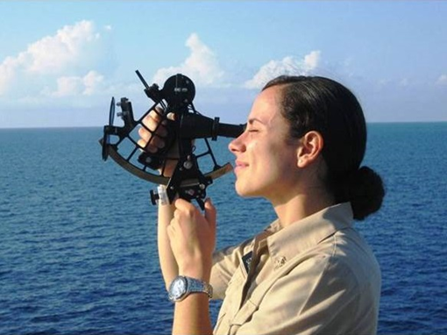
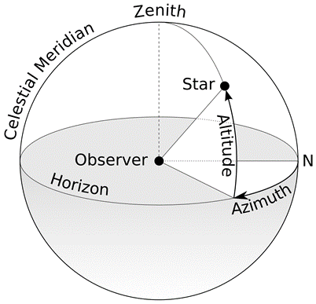
Horizon Coordinate System
-We calculate the Azimuth and Altitude of at least 3 CB’s at a specific time and place during Twilight. These are based on our AP.
-The calculated Altitude is called the Height Calculated (HC).
-We take a measurement of the CB’s Altitude with a Sextant. This is called taking a “sight”.
-The Altitude we observe with the Sextant is called the Height Observed (HO).
90-ALTITUDE = CO-ALTITUDE
CO-ALT x 60NM = Distance from GP to AP
We now have an LOP!!!!
SEANAV I United States Naval Academy
NN220 – Fundamentals of Navigation
Operations Officer I HMS PROTECTOR A173 I The Ice Patrol Ship

Slide 50
The Navigation Triangle
The remaining vertices is between the GP and AP for which we want to calculate distance.
North Pole
Based on our AP at a known time, we can calculate the Altitude of a Celestial Body.
CO-DEC
CO-LAT
Altitude is measured as a right Angle between the Celestial Body, GP and AP.
Where the measurement of the CB is called the Altitude, the remaining angle to 90 above the AP is the Co-Altitude.
GP
AP
Equator
90 – ALTITUDE = CO-ALTITUDE
CO-ALT is measured as an Angle.
CO-ALT x 60nm = Distance GP to AP.
The Distance GP to AP can be described as an LOP.

Slide 51
Navigational Triangle
Using Spherical Trigonometry we can calculate the distance between the GP and AP in Nautical Miles.
Just like with a Radar, this gives us a circular LOP on the Earth’s surface that can be plotted.
Polar North
Geographic Position (GP)
Assumed Position (AP)
Navigational
Triangle
(Pole-GP-AP)

Slide 52
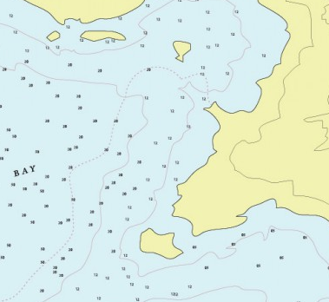
Using a Line Of Position
Using Radar we can generate a Line of Position (LOPs) based on the range to a charted object.
From a single radar range, we can draw a circle from which all we know is that we are somewhere on the circle. The range is the same from any position.
Taking a second range provides 2 possibilities as to where we might be.
Only when we get a 3rd range can we be sure that we are located where the 3 LOPs intersect.
Celestial Navigation uses the same premise although on a much larger scale as the distanced between our AP and the GP of a Celestial Body could be thousands of miles.
So we need to get a minimum of 3 LOPs from 3 separate Celestial Bodies to gain a Celestial Fix

Slide 53
Horizon Coordinate System
Video: https://www.youtube.com/watch?v=i2e0aRtwsCY
SEANAV I United States Naval Academy
NN220 – Fundamentals of Navigation
Operations Officer I HMS PROTECTOR A173 I The Ice Patrol Ship

Slide 54
Review
What is the Celestial Sphere?
A way of presenting all Celestial Bodies in relation to Earth with us at the center
What is the coordinate system of the Celestial Sphere?
Declination and Greenwich Hour Angle
What are the reference points for the Celestial Sphere?
The Celestial Poles (N / S), the Equinoctial (Celestial Equator) and the Greenwich Meridian
What is Declination?
The angle of a Celestial Body to the North or South of Equinoctial (Celestial Equator)
What is GHA?
The angle of the Celestial Body measured West (clockwise) from the Greenwich Meridian. It is a value between 0-360°.
What are the 3 vertices of the Celestial Triangle?
The Celestial Pole, Observer’s Zenith and the Celestial Body
SEANAV I United States Naval Academy
NN220 – Fundamentals of Navigation
Operations Officer I HMS PROTECTOR A173 I The Ice Patrol Ship

Slide 55
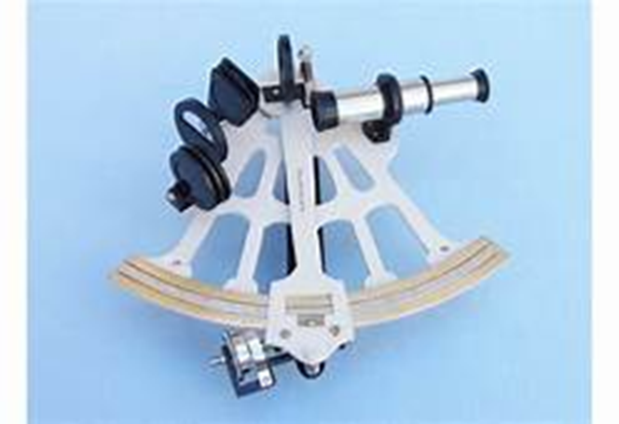
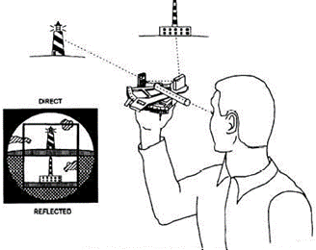
The Sextant
-We use the Sextant to measure angles in Degrees, Minutes and Seconds.
-It can measure a value between 0°-135°.
-The Sextant uses mirrors to look at two objects simultaneously.
-We measure the altitude between our visible horizon and a CB. The value will be between 0°-90°.
-Can also be used for surface navigation by:
-Measuring the angle between two objects horizontally.
-Measuring the vertical height of an object to get an LOP (RADAR range).
SEANAV I United States Naval Academy
NN220 – Fundamentals of Navigation
Operations Officer I HMS PROTECTOR A173 I The Ice Patrol Ship

Slide 56
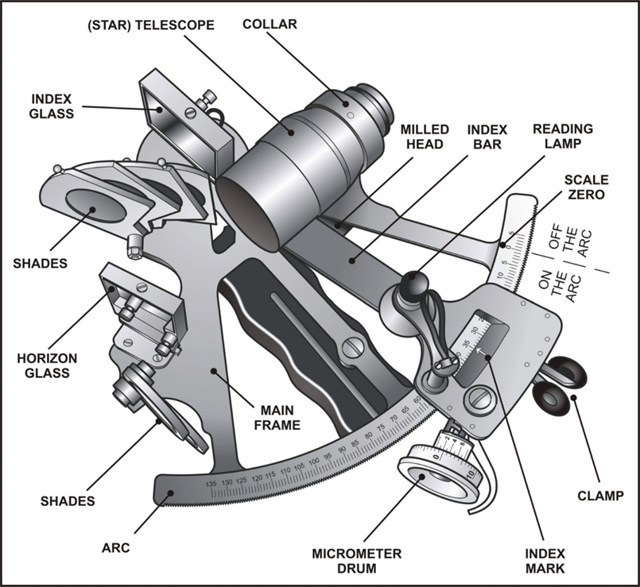
The Sextant
SEANAV I United States Naval Academy
NN220 – Fundamentals of Navigation
Operations Officer I HMS PROTECTOR A173 I The Ice Patrol Ship

Slide 57
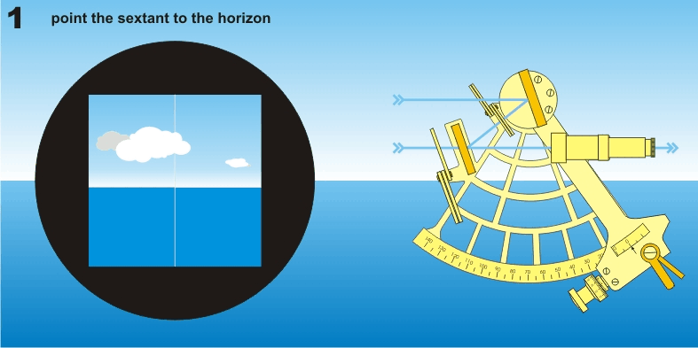

Slide 58
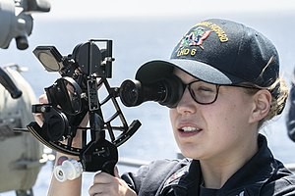
Sextant Errors
-The Sextant needs to be calibrated for accuracy before use.
-There are 4 adjustable errors that need to be checked before use.
-The errors are:
Index Error
Perpendicularity Error
Side Error
Collimation Error
-Sextant has fragile components. Treat them carefully or they will break.
SEANAV I United States Naval Academy
NN220 – Fundamentals of Navigation
Operations Officer I HMS PROTECTOR A173 I The Ice Patrol Ship

Slide 59
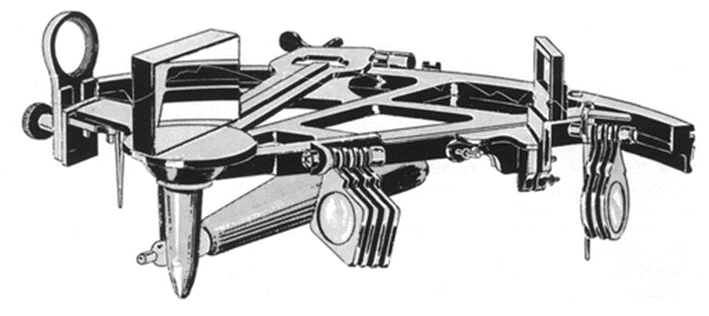
Perpendicularity
Error
-To test for Perpendicularity Error, place the index arm to about 35° on the arc and hold the sextant on it side with the index mirror up and toward the eye.
-If the two views are not joined in a straight line, the index mirror is not perpendicular.
-Use an Alan key on the screws behind the index mirror to adjust and correct.
Imperfect Arc (needs to be adjusted!)
SEANAV I United States Naval Academy
NN220 – Fundamentals of Navigation
Operations Officer I HMS PROTECTOR A173 I The Ice Patrol Ship

Slide 60
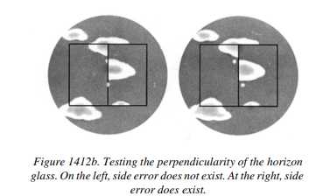
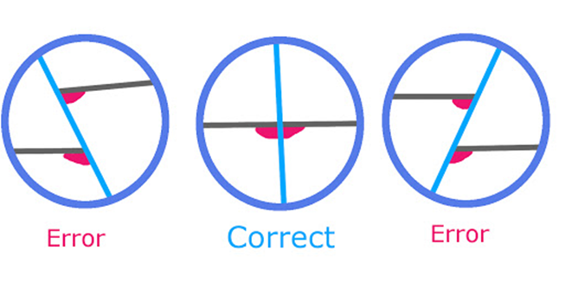
Side Error
-An error resulting from the horizon glass not being perpendicular to the frame is called Side Error.
-Set the index arm at zero and direct the line of sight at a star.
-The direct and reflected image should appear as one when looking at an object when the arc is moved through zero.
-Use an Alan key on the Horizon glass to correct.
SEANAV I United States Naval Academy
NN220 – Fundamentals of Navigation
Operations Officer I HMS PROTECTOR A173 I The Ice Patrol Ship

Slide 61
Collimation Error
-If the line of sight through the telescope is not parallel to the plane of the instrument, a collimation error will result.
-Higher than normal sextant altitudes will be measured.
-Adjust the collar to correct.
-Modern manufacturing techniques have eliminated most collimation errors at smaller angles.
SEANAV I United States Naval Academy
NN220 – Fundamentals of Navigation
Operations Officer I HMS PROTECTOR A173 I The Ice Patrol Ship

Slide 62
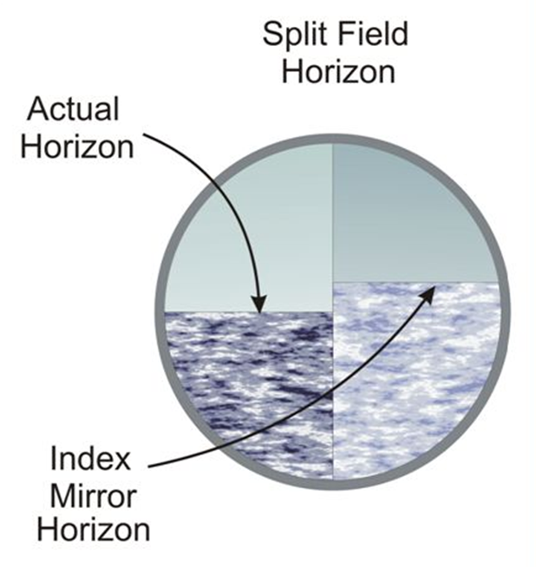
Index Error
-Index Error is the error remaining error after all other errors have been corrected.
-With Index Error, the index mirror and horizon glass will not be aligned when the arm is set to zero.
-Adjust the sextant reading until the images are aligned.
SEANAV I United States Naval Academy
NN220 – Fundamentals of Navigation
Operations Officer I HMS PROTECTOR A173 I The Ice Patrol Ship

Slide 63
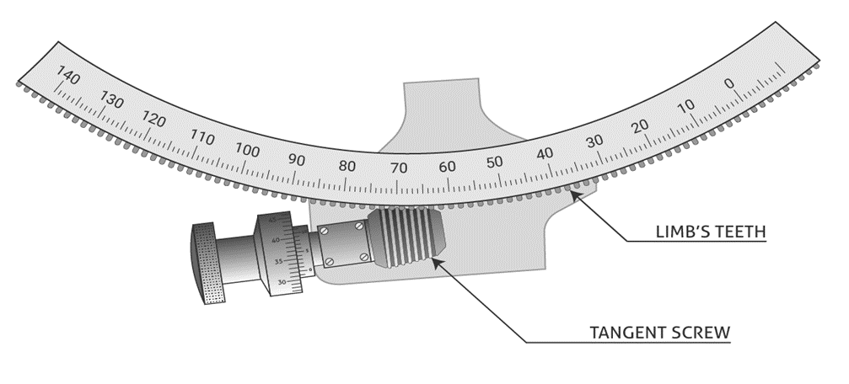
Index Error
-Index Error is described as being On The Arc or Off The Arc.
-To achieve accurate sights, we will need to account for this error by either subtracting or adding the value to our sights.
-On The Arc means you have a POSITIVE value when you align the two images. Your sextant is reading high and this value must be SUBTRACTED from your sights.
-Off the Arc means you have a NEGATIVE value when you align the two images. Your sextant is reading low and this value must be ADDED to your sights.
On the Arc
Off the Arc
SEANAV I United States Naval Academy
NN220 – Fundamentals of Navigation
Operations Officer I HMS PROTECTOR A173 I The Ice Patrol Ship

Slide 64
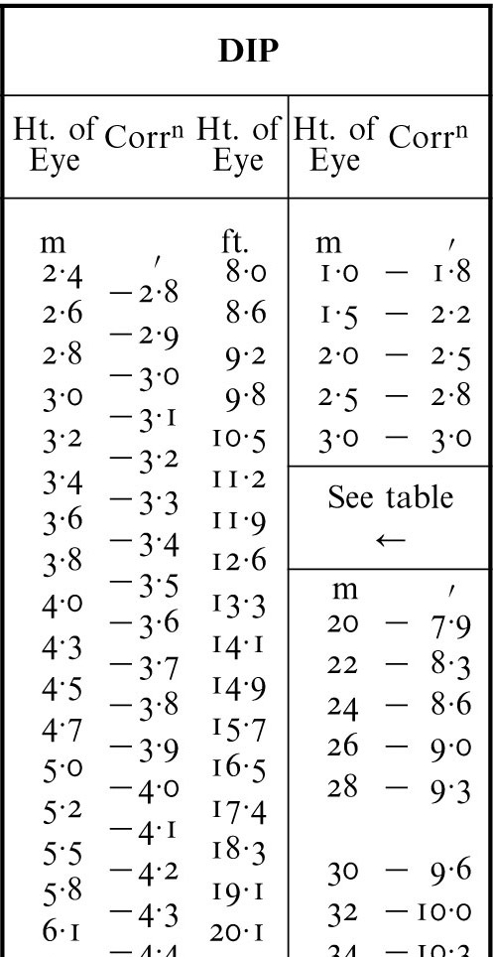
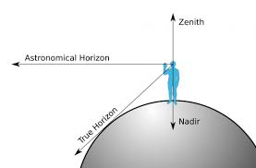
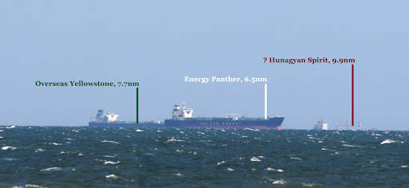
Adjusting The Sight
Once the instrument is calibrated, we can take a Sight. However, the measured angle must be adjusted for external influences before the value can be used.
Dip is the correction for our Height of Eye in relation to the Visible Horizon.
We normally take sights from the Bridge wing, the height of which varies dramatically between a YP, DDG and CVN for example. The higher we are, the further away we see. This is the Apparent or True Horizon.
For CELNAV we use the Astronomical Horizon at 90° to our Zenith. Therefore, the higher we are, the more we must adjust for that height.
Based on our height, the corresponding number of minutes of Altitude are subtracted from our Sextant value.

Slide 65
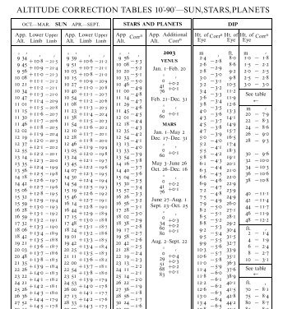
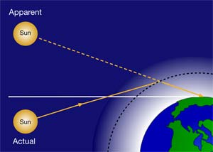
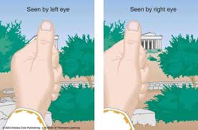
Adjusting The Sight
Refraction is when the path of light is bent, such as when light from the Sun comes into contact with the atmosphere.
This means that the Apparent position of the Sun that we see, is not the same as its actual position.
Temperature and Barometric pressure also have an impact on Refraction.
Parallax error is the perceived shift of position due to the angle of observation. A Celestial Body’s GP relates to the center of the Earth but we aren’t standing there.
The values for these corrections can also be found in the Nautical Almanac.

Slide 66
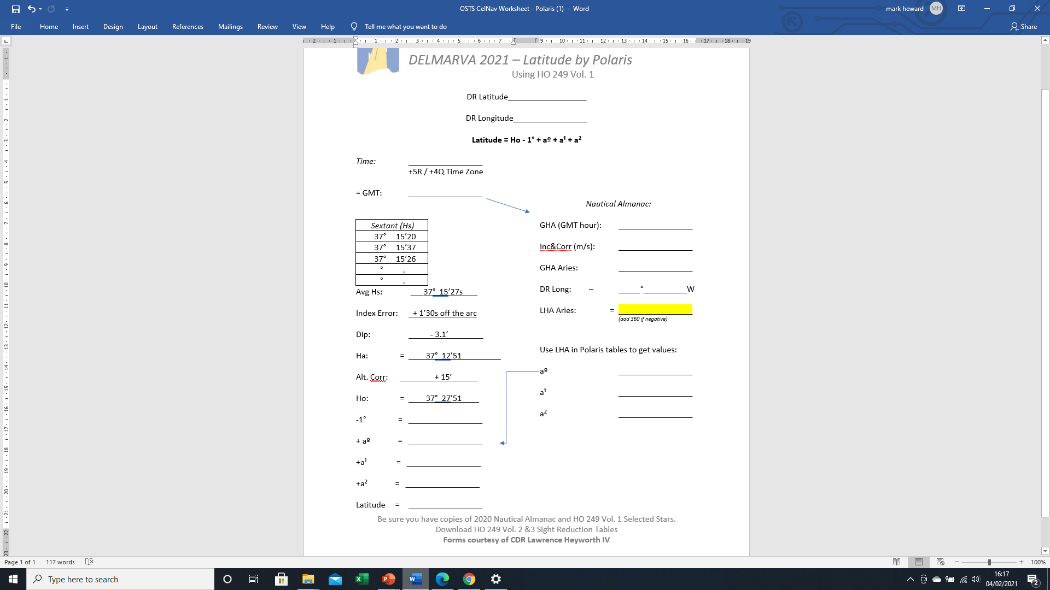

Adjusting The Sight
When conducting Celestial Navigation manually, by hand, the Publications, tables and math provide us the means of correcting for these errors.
So from our Observed Altitude taken by the Sextant, we adjust for:
Index Error of the Sextant
Dip in relation to the Height of Eye
Altitude of the Body, including refraction
This math gives us the corrected Height Observed (HO).
Fortunately, systems such as STELLA do the math for us!

Slide 67

Sextant Tutorial
Taking Sights with a Sextant: https://www.youtube.com/watch?v=7wKhsOQlmCY

Slide 68

Navigate at Sea Activity: https://timeandnavigation.si.edu/navigating-at-sea/challenges/navigate-the-sea-activity

Slide 69
Enabling Objectives
1 – DESCRIBE the Terrestrial sphere and coordinate system. 2 - DESCRIBE How we perceive the Universe and Solar System in relation to the Earth. 3 - DESCRIBE the Celestial Sphere and Celestial Coordinate System. 4 - DESCRIBE the First Point of Aries in relation to Celestial Bodies. 5 - INTRODUCE the Nautical Almanac and STELLA. 6 - DEFINE the terms Assumed Position, Geographic Position and Observer’s Zenith in relation to the Celestial and Terrestrial Spheres. 7 - DEFINE the calculation for the relative movement of the Sun and Celestial Bodies. 8 - EXPLAIN the Celestial and Terrestrial Triangles and their relationship. 9 - EXPLAIN How to calculate CO-ALTITUDE and distance between the GP and AP from Altitude to gain an LOP. 10 - DESCRIBE The Horizon Coordinate System and its relationship to Altitude, Azimuth, GHA and Declination. 11 - INTRODUCE The Nautical Sextant. 12 - DEFINE The Nautical Sextant errors of Index Error, Perpendicularity, Side Error and Collimation Error. 13 - EXPLAIN Height Observed in relation to Height of Eye, Refraction and Environmental corrections.
SEANAV I United States Naval Academy
NN220 – Fundamentals of Navigation
Operations Officer I HMS PROTECTOR A173 I The Ice Patrol Ship

Slide 70

Questions?
SEANAV I United States Naval Academy
NN220 – Fundamentals of Navigation
Operations Officer I HMS PROTECTOR A173 I The Ice Patrol Ship

